Slide 1
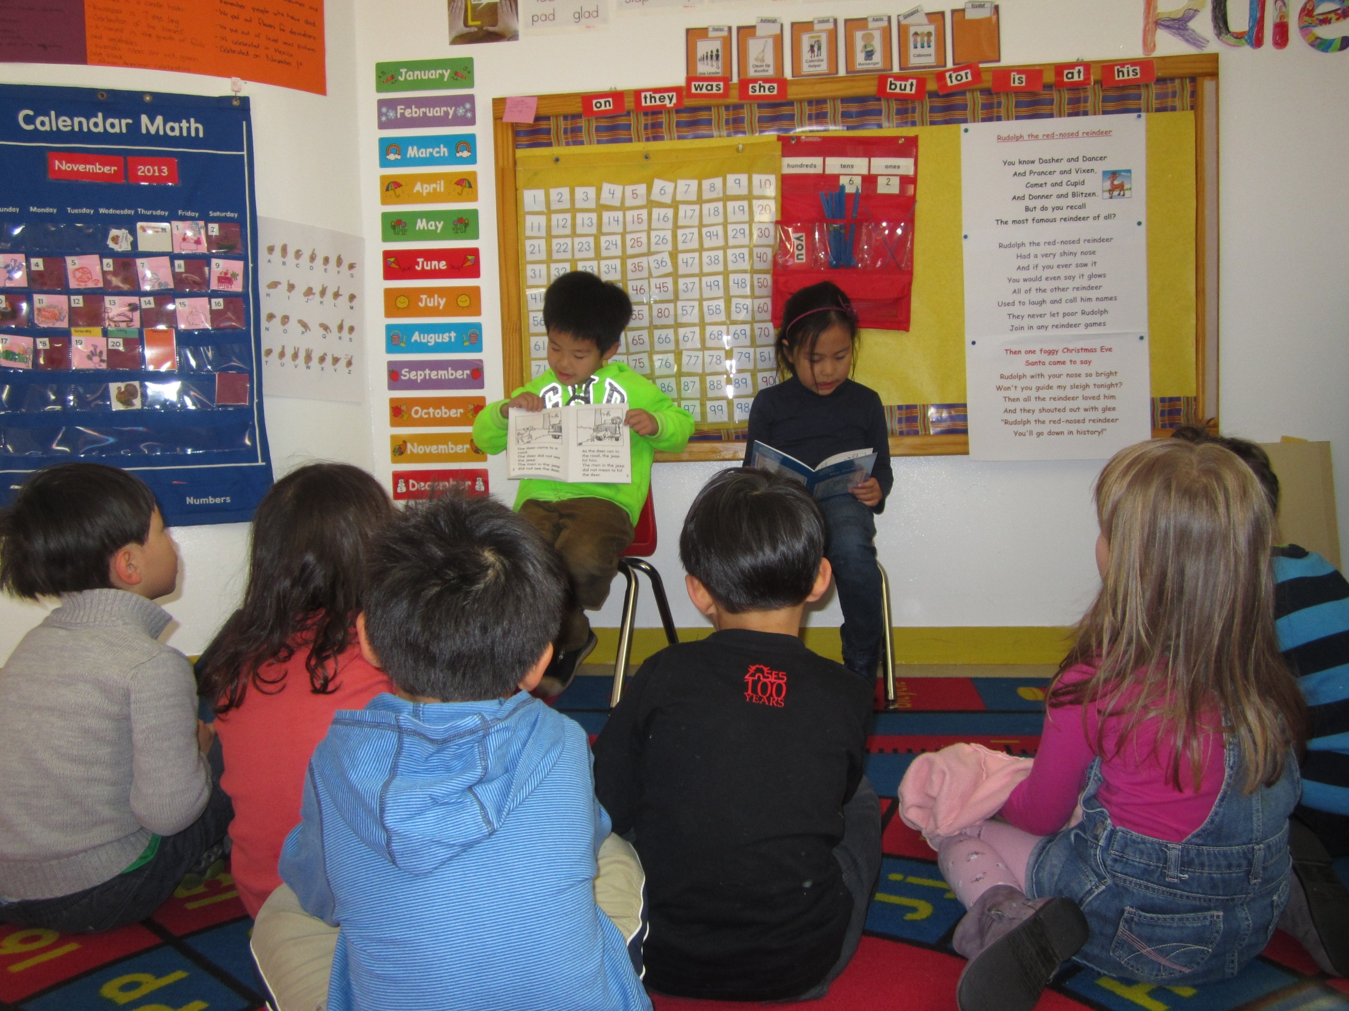
Language Arts in the Early Childhood Program – Literacy Foundation
My Name:Vosa_Cavu_Litman

Slide 2
Foundations of Literacy
Oral language development
Concepts about print
Alphabet knowledge
Phonological awareness
Letter-sound correspondence
Beginning reading vocabulary

Slide 3
ECLC’s Approach to Learning
Phases of Learning
1: Beginning Phase of Learning
2: Early Phase of Learning
3: Exploratory Phase of Learning
4: Emergent Phase of Learning
5: Consolidated Phase of Learning

Slide 4
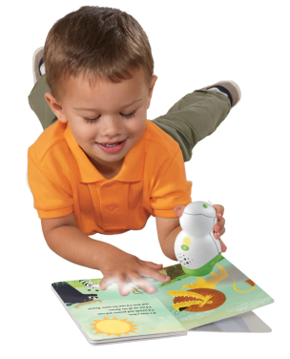
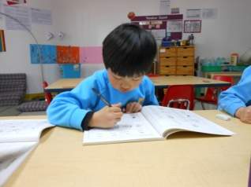
Breaking Down Language Arts
1. Oral Language
2. Reading
Book Knowledge and Comprehension
3. Writing
From Scribbles to Letters
Growing Interest in Print
Developing Fine Motor Skills
Language Exposure and Opportunities
Language Manipulation

Slide 5
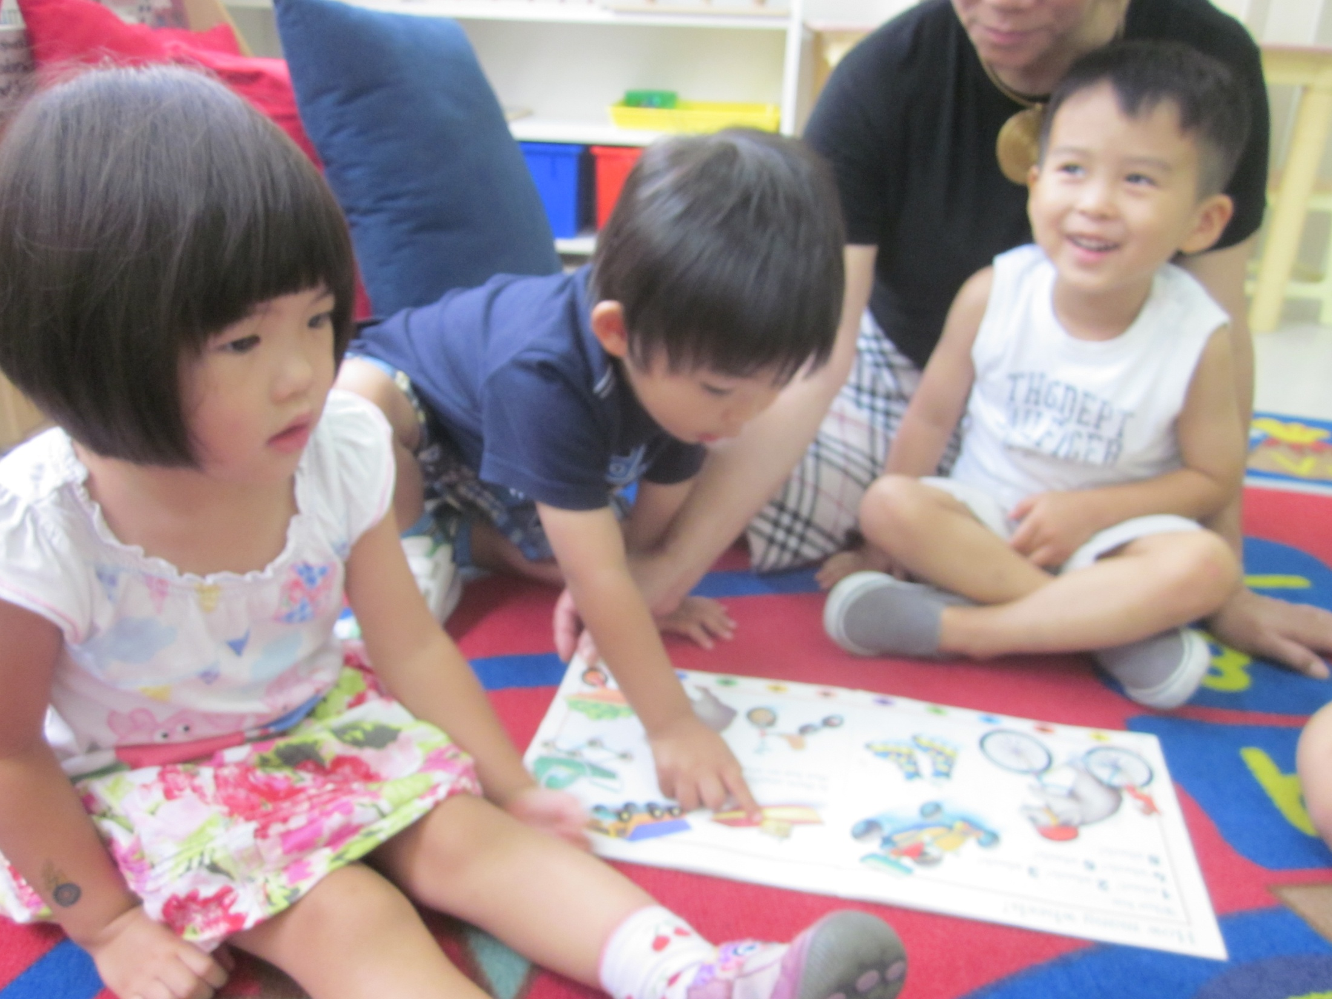
Oral Language Development
stories have events that occur in sequence
stories have characters
be able to respond to questions
be able to ask questions to clarify what is not
understood
Oral Language Continuum

Slide 6
TIME OUT!!!
http://www.youtube.com/watch?v=p4ok1TAqe5k

Slide 7
OK, back to Oral Language
Beginning Phase
In this phase children are motivated by a basic need to communicate; to understand and be understood.
“Play teddy”.
“Me jump”.
Early Phase
Using language to satisfy simple social needs, to gain control of objects, people and knowledge in the environment.
* experiments with sounds through rhythm and repetition
* demonstrates an understanding of most common prepositions e.g. on, under, front, behind
Notes:
Prior to the Beginning Stage,
- noise and sound response occurs
- different cries for different needs
- babbling!

Slide 8
Exploratory Phase
Become attentive to sound structure through listening.
Will include most grammatical patterns.
Use language to express meaning and share experiences
Emergent Phase
Use language to satisfy social and communicative needs.
Consolidated Phase
Understand how listening, speaking, writing and reading complement each other as tools for learning.

Slide 9
Reading Continuum

Slide 10
Concepts about Print
Print conveys meaning, not pictures
Print is tracked from left to right and top to bottom
Words are separated by spaces

Slide 11
You, yes YOU, take a try… You have 5 SECONDS Ready… Get Set… GO

Slide 12
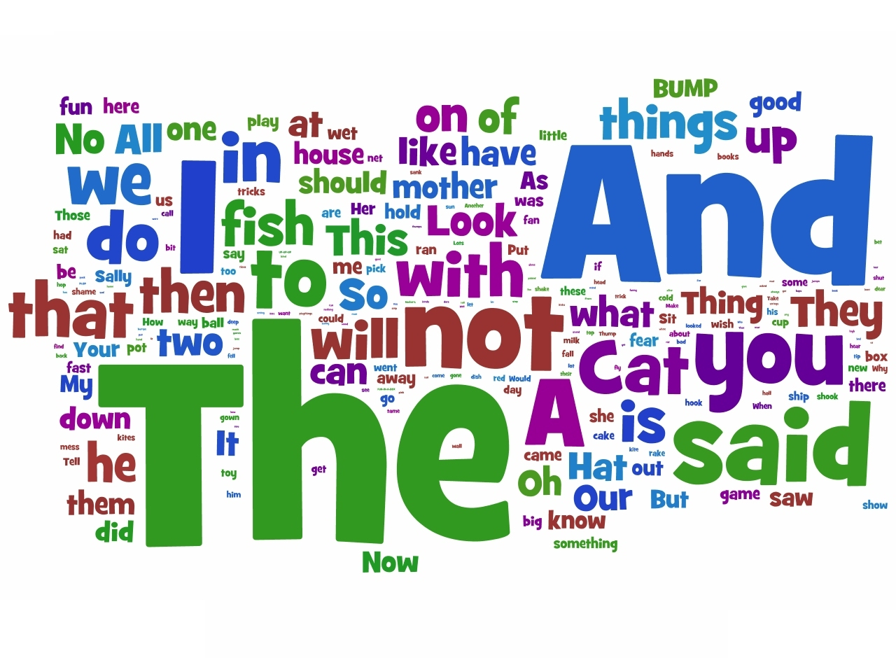

Slide 14
Again! Ready… Get Set… GO

Slide 17
Again! Ready… Get Set… GO!
Last______Time

Slide 18
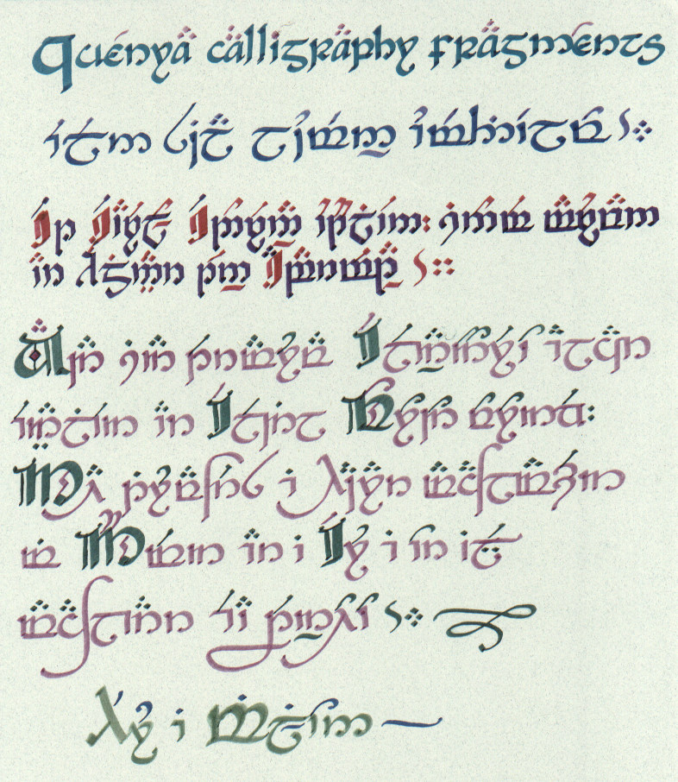

Slide 19
TIME!!!
TIME!!!
TIME!!!
TIME!!!
TIME!!!

Slide 20
Now on to
r-eyE-ting

Slide 21
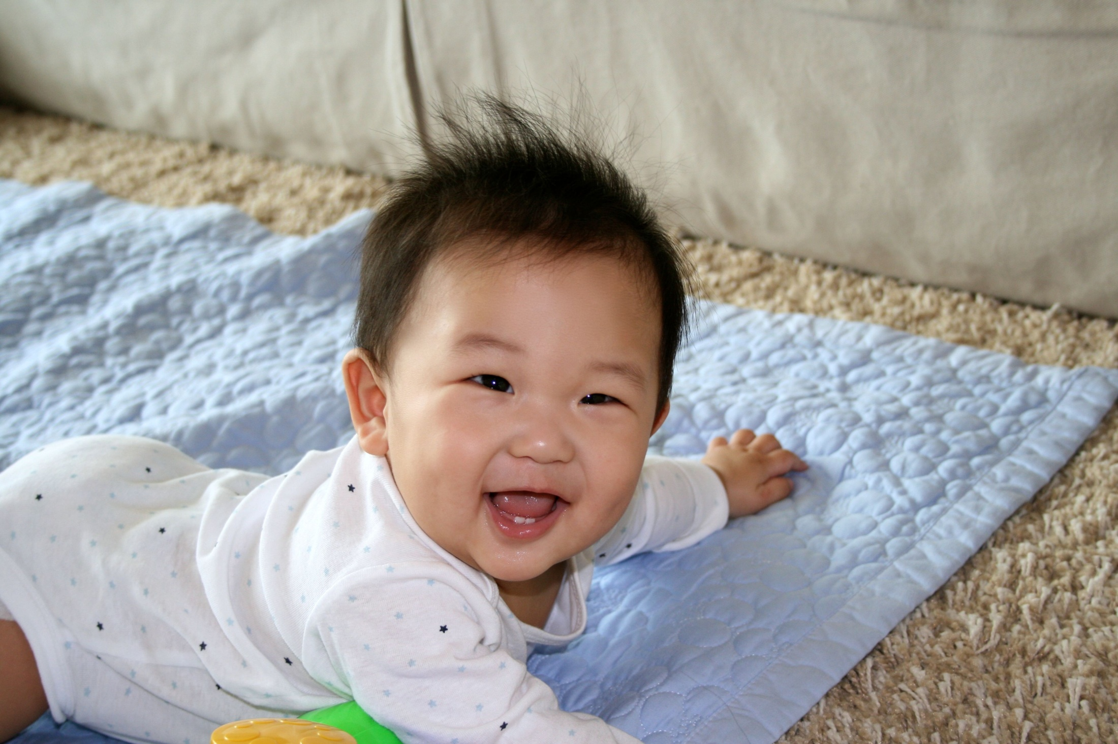
Writing Through the Phases

Slide 22
Writing Through the Phases

Slide 23
Writing Through the Phases

Slide 24
“Writing is thinking and thinking is hard work” --Lewis Black

Slide 25
Questions?

